Slide 1
Introduction to IECA DNN Platform
Presented by Hanjun Dai

Slide 2
Outline
Platform Overview
Environment Setup
Platform Usage
Policy

Slide 3


Platform Overview: Architecture
Main.cpp (user code)
Nets.lib
User Focused
NNCore.lib
IECAMatrix.lib
Developer Focused
Common.lib
Dependency

Slide 4
Platform Overview: Features_Common.lib
Common.lib contains useful utilities
Dictionary.h: a C# like hash table, which is faster than std::map
HuffmanEncoder.h: generate Huffman Tree from term frequency
ConfigParser.h: an .ini file parser
Log.h: a ‘printf’ like logger
Timer.h: a timer with tags
CMultinomialSampler.h: a multinomial sampler

Slide 5
Platform Overview: Features_IECAMatrix.lib
IECAMatrix
Uniform.
A Uniform Matrix Library works on GPU/CPU and in Sparse/Dense format.
Efficient.
Utilize MKL and CUDA to speed up matrix arithmetic computations. Faster than Eigen.
Elegant.
Almost no difference with integer/float computations. Easy to use.
#define MODE MatMode::CPU
auto a = DenseMat<MODE>(10, 10);
auto b = SparseMat<MODE>(10, 5);
auto c = DenseMat<MODE>(5, 10);
a -= b * c * 0.001f;

Slide 6
Platform Overview: Features_NNCore.lib
Layer_1
Layer_2
Key elements: Layer and Connection
Current Release:
Easy to build any DAG-like neural network;
Flexible to configure:
Layer: #neurons, act/loss fuctions, sparse/dense
Connection: sparse/dense, FeedForward/BackPropagation behaviros
Generalized dataset
Sparse/Dense, Text/Binary format Matrix storage;
Streaming data; local shuffled.
Softmax Approximation
HuffmanEncoding, NegativeSampling
Thread-level data parallelism
Conection_1

Slide 7
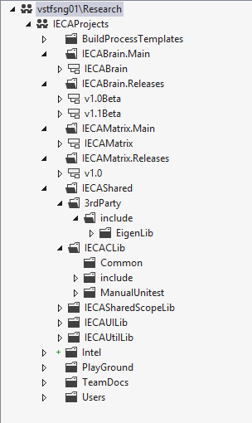
Platform Overview: Code Framework-TFS
Code organization in TFS
IECABrain Developer Branch
IECABrain Release Branch
IECAMatrix Developer Branch
IECAMatrix Release Branch
3rd Party libraries, like Eigen Lib
Common.lib

Slide 8
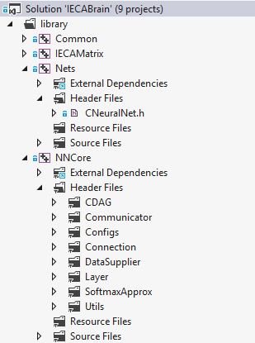
Platform Overview: Code Framework-IECABrain
Code organization in IECABrain
Just a wrapper of NN logic
Handle DAG structure (validation check, topological sort)
Responsible for multi-machine communication
Training configurations (like learning rate, L2 penalty, etc.)
Define connections and their behaviors
Supply streaming data for multiple layers and multiple thread model replicas
Define layers and their behaviors
Do softmax approximation (especially for word2vec tasks)
Useful tools

Slide 9
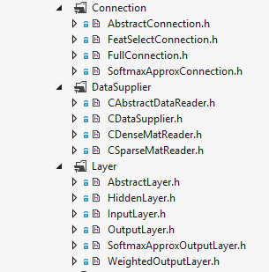
Platform Overview: Code Framework-IECABrain-Core
Possible for user to do further implementation
Common base class for Connections.
Common base class for Data Readers
Common base class for Layers
To write your own code, you must inherit corresponding
abstract classes, and implement the required virtual methods.

Slide 10
Environment Setup: Installation
Install necessary software
Please refer to OneNote page Build project from TFS for more information
Install Cuda 5.5;
Download MKL redistribution from MSRA-IRM100;
Setup MKL environment variables;
Install MS MPI (the latest version);
Restart your computer.

Slide 11
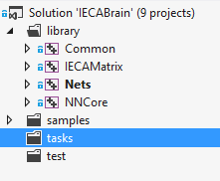
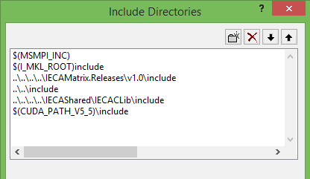
Environment Setup: Project Configuration
1. Add a new empty c++ project under tasks folder
MPI include
MKL include
2. Setup include paths
IECA Matrix include
IECABrain headers
Common.lib header files
CUDA include

Slide 12
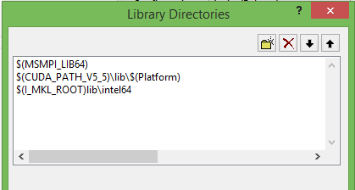
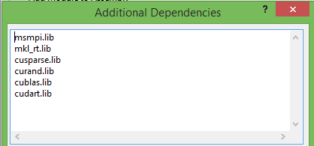
Environment Setup: Project Configuration
3. Setup library paths
MS MPI 64-bit lib
4. Add library dependencies
MKL 64-bit lib
CUDA lib
Note:
Please do configuration for all platform (32/64) and all configuration (Debug/Release)
32 and 64 have different library paths
Add _CRT_SECURE_NO_WARNINGS to C++ preprocessor
You can also refer to sample projects for more information.

Slide 13
Platform Usage: Tasks supported
Input Format | Model Format | Case | CPU matrix | CPU NN | CPU Efficiency | GPU matrix | GPU NN
Dense | Dense | MNIST | Yes | Yes | 6.6s | Yes | Yes
Sparse | Dense | Sparse MNIST | Yes | Yes | 9s | Yes | Yes
Sparse | Dense | Click prediction | Yes | Yes |  | Yes | Yes
Sparse | Dense | Word2vec | Yes | Yes | 20s | Yes | Yes
Dense/Sparse | Sparse | Local connection | Yes | No |  | Yes | No

Slide 14
Platform Usage: Train a simple MNIST
You can refer to sample code for more information.
1. Initialize our platform
CMPIComm::Init(argc, argv); // Init MPI Comm
const MatMode mode = MatMode::CPU; // Set Mode
TrainingConfig* pTConfig = new TrainingConfig(); // Create Training Config
pTConfig->uThreadReplicaCnt = 1;
pTConfig->uBatchSize = 100;
pTConfig->uMaxEpochCount = 1;
IMatrix<mode>::Initialize(pTConfig->uThreadReplicaCnt); // Initialize Matrix Engine

Slide 15
Platform Usage: Train a simple MNIST
2. Create Layer Information Structures
Please refer to Struct Constructor for more information
CDataSupplier* pSupplier = new CDataSupplier(
pTConfig->uThreadReplicaCnt, pTConfig->uBatchSize);
InputLayerInfo<mode>* pInputInfo = new InputLayerInfo<mode>( MatFormat::Dense, 0, 784, false, pSupplier);
HiddenLayerInfo<mode>* pHiddenInfo_1 = new HiddenLayerInfo<mode>( MatFormat::Dense, 1, 1024, true, new CRectify<mode>());
HiddenLayerInfo<mode>* pHiddenInfo_2 = new HiddenLayerInfo<mode>( MatFormat::Dense, 2, 1024, true, new CRectify<mode>());
OutputLayerInfo<mode>* pOutInfo = new OutputLayerInfo<mode>(
MatFormat::Dense, 3, 10, true, pSupplier, new CSoftmax<mode>(), new CLogLoss<mode>());
Matrix format
ID
Size
Will BP?
Where Data Comes?
What Activation Func is?
What Loss Func is?

Slide 16
Platform Usage: Train a simple MNIST
3. Build DAG structure and set readers
CDAGStructure<mode> dagStruct;
dagStruct.AddLayer(pInputInfo);
dagStruct.AddLayer(pHiddenInfo_1);
dagStruct.AddLayer(pHiddenInfo_2);
dagStruct.AddLayer(pOutInfo);
pInputInfo->RegisterReader(new CDenseMatReader(0, pInputInfo->layerSize, FileStorageMode::Binary));
pOutInfo->RegisterReader(new CDenseMatReader(1, pOutInfo->layerSize, FileStorageMode::Binary));
ID
Size
Data Format
4. Create 3 connections
ID
Size_0
Size_1
FullConnection<mode>* pConn_0_1 = new FullConnection<mode>(0, 784, 1024, BiasStatus::UseBias);
FullConnection<mode>* pConn_1_2 = new FullConnection<mode>(1, 1024, 1024, BiasStatus::UseBias);
FullConnection<mode>* pConn_2_3 = new FullConnection<mode>(2, 1024, 10, BiasStatus::UseBias);

Slide 17
Platform Usage: Train a simple MNIST
5. Add Connections, and do initialization for weights
pConn_0_1->pWeights->SetUniformRandom(-0.1f, 0.1f);
pConn_1_2->pWeights->SetUniformRandom(-0.1f, 0.1f);
pConn_2_3->pWeights->SetUniformRandom(-0.1f, 0.1f);
dagStruct.AddConnection(0, 1, pConn_0_1);
dagStruct.AddConnection(1, 2, pConn_1_2);
dagStruct.AddConnection(2, 3, pConn_2_3);
6. Create new Neural Network; add a dataset
CNeuralNet<mode> net(&dagStruct, pTConfig);
net.AddDataset("MNIST", pSupplier);

Slide 18
Platform Usage: Train a simple MNIST
7. Train and Test
std::vector<std::pair<unsigned, std::string> > training_files;
training_files.push_back(std::pair<unsigned, std::string>(0, "train_image_whole.data"));
training_files.push_back(std::pair<unsigned, std::string>(1, "train_label.data"));
net.SetFiles("MNIST", training_files);
net.TrainAll();
std::vector<std::pair<unsigned, std::string> > test_files;
test_files.push_back(std::pair<unsigned, std::string>(0, "test_image_whole.data"));
test_files.push_back(std::pair<unsigned, std::string>(1, "test_label.data"));
net.SetFiles("MNIST", test_files);
net.TestAccuracy();
CMPIComm::Finalize(); // don't forget to finalize mpi

Slide 19
Platform Usage: Train a sparse MNIST
Simple modifications:
1. Sparse input layer:
InputLayerInfo<mode>* pInputInfo = new InputLayerInfo<mode>(
MatFormat::Sparse, 0, 784, false, pSupplier);
2. Register sparse input reader:
pInputInfo->RegisterReader(new CSparseMatReader(0, pInputInfo->layerSize, FileStorageMode::Binary));

Slide 20
Platform Usage: Train word2vec with HS/NS
You can refer to sample code for more information.
1. Load term frequency, build Huffman Tree/Set Multinomial Sampler
HuffmanEncoder* pEncoder = new HuffmanEncoder();
pEncoder->BuildFromTermFrequency("D:/TFS/IECAProjects/dataset/word2vec/text8_word_cnt.txt");
uVocabSize = (unsigned)pEncoder->GetLabelSize();
pOutInfo = new SoftmaxApproxOutputLayerInfo<mode>(
MatFormat::Sparse, 2, uVocabSize, true, pSupplier,
new CHrchySoftmaxApproximator(pEncoder, pTConfig->uThreadReplicaCnt));
2. Sparse input layer; Softmax Approximation Output Layer/Connection
Currently, the sample code use general matrix format to represent the data.
You can write your own data reader to support slide-window like inputs.

Slide 21
Platform Usage: Write your own code
1. Build project under /task folder
Refer to section ‘Environment Setup’ for more information
2. Write your own Connection:
Refer to AbstractConnection.h
Inherit AbstractConnection (or its child classes) and override the following two virtual functions.
virtual void FeedForward(AbstractLayer<mode>* pLayerFrom, AbstractLayer<mode>* pLayerTo) = 0;
virtual void BackPropagation(
const TrainingConfig* pTrainingConfig, AbstractLayer<mode>* pLayerFrom, AbstractLayer<mode>* pLayerTo, bool propagateError) = 0;

Slide 22
Platform Usage: Write your own code
3. Write your own Layer
Refer to AbstractLayer.h
a. Inherit AbstractLayerInfo (or its child classes) and override the following two virtual functions.
// Tell me how to create your layer object
virtual AbstractLayer<mode>* CreateLayer(unsigned _uThreadReplicaID = 0) = 0;
virtual LayerType GetType() const = 0;
// Tell me what is your layer type (input, hidden, or output)
b. Inherit AbstractLayer (or its child classes) and override the following four virtual functions.
virtual bool PrepareFeedForward() = 0;
virtual void PrepareBackPropagation(const TrainingConfig* pTrainingConfig) = 0;
virtual void Activate() = 0;
virtual void CalcErr() = 0;

Slide 23
Platform Usage: Write your own code
3. Write your own Layer
Refer to AbstractLayer.h
The Feed Forward logic is organized as follows:
The Back Propagation logic is organized as follows:
ResetActivations();
if (!PrepareFeedForward())
return false;
for (auto& edge : inConns)
{
if (CMPIComm::IsInProcess(edge.first->uProcID))
edge.first->FeedForward(edge.second, this);
}
Activate();
return true;
ResetErrors();
PrepareBackPropagation(pTrainingConfig);
for (auto& edge: outConns)
{
if (CMPIComm::IsInProcess(edge.first->uProcID))
edge.first->BackPropagation(pTrainingConfig, edge.second, this, pLayerInfo->bpError);
}
CalcErr();

Slide 24
Platform Usage: Write your own code
4. Write your own Reader
Refer to CAbstractDataReader.h
Inherit CAbstractDataReader(or its child classes) and override the following three virtual functions.
// Tell me how to open a file
virtual void Open(std::string filename) = 0;
virtual unsigned LoadBatchSamples(IMatrix<MatMode::CPU> *&batch, unsigned uBatchSize) = 0;
virtual void Close() = 0;
// Tell me how to get a mini-batch of data; you should set the batch Matrix
// Tell me how to close your reader after one epoch of training

Slide 25
Platform Usage: Write your own code
5. Write your own Act/Loss Functions
Refer to matrix_act_func.h/matrix_loss_func.h
Inherit CAbstractActFunc(or its child classes) and override the following four virtual functions.
inline virtual void Act(DenseMat<mode>& states) { }
inline virtual void Act(SparseMat<mode>& states) { }
inline virtual void Deriv(DenseMat<mode>& states, DenseMat<mode>& errors) { }
inline virtual void Deriv(SparseMat<mode>& states, SparseMat<mode>& errors) { }
Inherit CAbstractLossFunc(or its child classes) and override the following four virtual functions.
inline virtual matEleType GetLoss(DenseMat<mode>& outputs, DenseMat<mode>& labels) {}
inline virtual matEleType GetLoss(SparseMat<mode>& outputs, SparseMat<mode>& labels) {}
inline virtual void Deriv(DenseMat<mode>& outputs, DenseMat<mode>& labels, DenseMat<mode>& errors) {}
inline virtual void Deriv(SparseMat<mode>& outputs, SparseMat<mode>& labels, SparseMat<mode>& errors) {}

Slide 26
Platform Usage: A sample for CNN implementation
ConvolutionalConnection derived from AbstractConnection
Feed Forward:
Change the form of last layer’s activation
Do matrix operations like standard connection
Pooling
Back Propagation
Change the form of last layer’s activation
Pass pooling error
Update weights and calculate next layer’s error
change error’s form and propagate to next layer

Slide 27
Platform Usage: Hints on writing code
1. Follow Taifeng Nomenclature (please refer to Taifeng’s code training slides)
2. Hints on playing with IECAMatrix
You’d better allocate memory for l-values before calculation;
Left side of ‘=‘ cannot appear on the right side of ‘=‘;
E.g. Write a += b instead of a = a + b;
Unsupported expressions will cause compile error.
Dense Matrix is Col-major; Sparse matrix use CSC storage format;
3. About memory allocation
Dynamically create/delete memory is costly;
Copy data between CPU/GPU is costly;
Pass arguments via reference (or const reference) to avoid unnecessary copy;
Use new and delete, instead of malloc and free;

Slide 28
Policy & Introduction to Branches
Developer(main)
Continue implement infrastructure/platform level next version
Release
Open to users
Add features / add samples
Don’t commit changes to existing code once get reviewed by platform team.
Valuable modification/additional features will be merged into main branch.

Slide 29
HPC usage
WSM template
MSR template
Low priority template
Request job using “core” as the unit
Please specify the core number
40 cores in single machine
2 GPU cards in single machine
GPU usage (mind this since current hpc has no way to allocate job on GPU automatically)
Include the shared lock in your program (check with Shuxin)

Slide 30
Thanks!

